Slide 1
Twitter Data Mining Project Geog476
John Kastner Joey Celtnieks Julia Bell

Slide 2
Introduction
Our project seeks to use the python module tweepy to access the Twitter API and find the geographic dispersion of tweets using partisan political hashtags.
#MAGA
#NotMyPresident
#HillaryForPrison
We will display these tweets based on their coordinates on a map of U.S., display whether each state had more “Red” or “Blue” tweets, and compare these maps to the election map of 2016

Slide 3
Tweepy Module
The tweepy module is used to access the twitter API and begin the process of data mining.
The tweepy module has the capability to stream tweets and produce a JSON dataset that includes several parameters.
This requires an input of the string (hashtag), and a specification of how many tweets we want returned
The JSON is converted into a .csv file with party affiliation and coordinates for each tweet

Slide 4
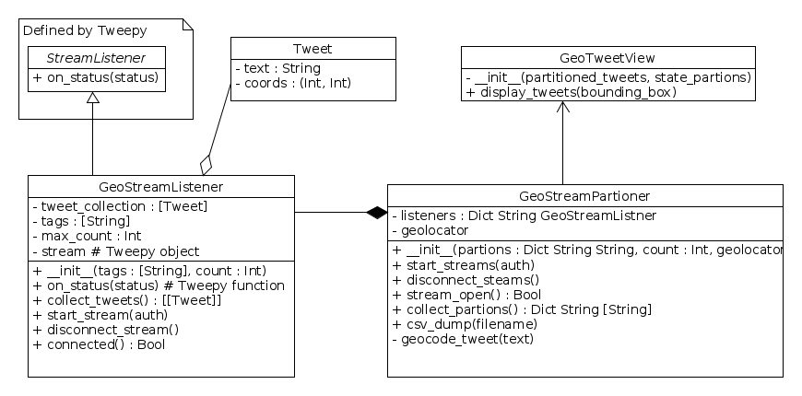
UML Diagram

Slide 5
Tweepy
Used to obtain tweets
CSV
Tweets, their political alignment, and their coordinates are stored in this file
Visualization
Tweet coordinates are aggregated into state boundary, and a choropleth is generated based on what is most tweeted in each state

Slide 6
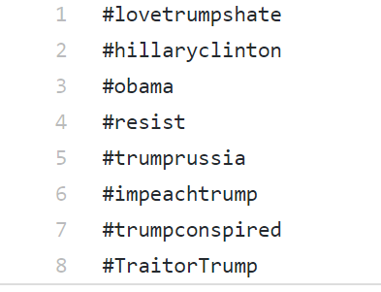
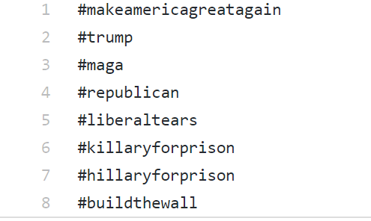
Inputs: Hashtags Text Files
Blue Tweets
Red Tweets

Slide 7
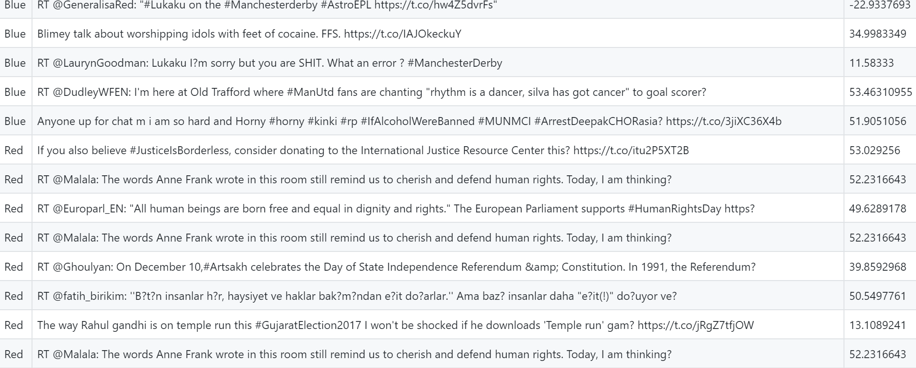
Output: CSV dump file

Slide 8
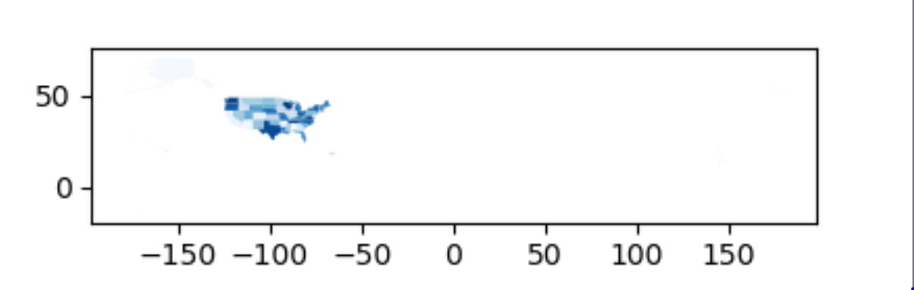
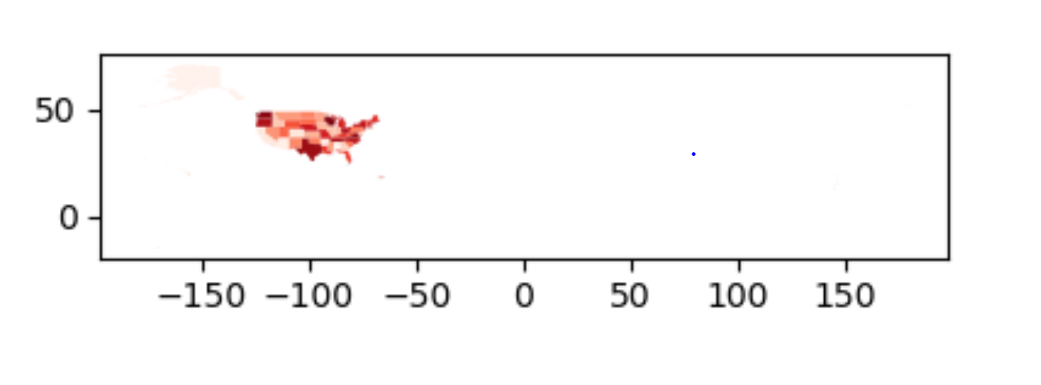
Output Maps

